Slide 1
Presentation of the collective agreement between LÍV and SA
14. Mars 2024

Slide 2
Overview
LÍV and SA signed a collective agreement on Thursday which is valid for four years, or until January 31, 2028.
The aim of the agreement is to increase the purchasing power of workers by contributing to the reduction of inflation and the reduction of interest rates.
This presentation will cover the main points of agreement:
Salary changes
December and holiday allowance
Vacation
Purchase rate increase and productivity increase
Government transfer system
Other issues (job-related courses, remote work, trustees, etc.)
Conditional clause
Special wage agreements

Slide 3
Wage changes
Wages take a proportional increase during the contract period, with a minimum ISK increase, as stated:
February 1, 2024: wages increase by 3.25% to ISK 23,750. at a minimum.
January 1, 2025: wages increase by 3.50% to ISK 23,750. at a minimum.
January 1, 2026: wages increase by 3.50% to ISK 23,750. at a minimum.
January 1, 2027: wages increase by 3.50%, but a minimum of 23,750.
Salary-related items increase correspondingly.

Slide 4
December- and vacation supplement
The December supplement for each calendar year based on full-time employment is:
In the year 2024 ISK 106,000.
In the year 2025 ISK 110,000.
In the year 2026 ISK 114,000.
In the year 2027 ISK 118,000.
Holiday supplement for each holiday year (May 1 to April 30) based on full-time employment is:
In the vacation year starting on May 1, 2024, the vacation allowance will be ISK. 58,000.
In the vacation year starting on May 1, 2025, the vacation allowance will be ISK. 60,000.
In the vacation year starting on May 1, 2026, the vacation allowance will be ISK. 62,000.
In the vacation year starting on May 1, 2027, vacation compensation will be ISK. 64,000.

Slide 5
Incresed vacation
As of May 1, 2024, there will be a vacation entitlement as follows (due to vacation taken during the vacation year starting on May 1, 2025):
An employee who has worked for 6 months at the same company and has reached the age of 22, or for 6 months at the same company after graduating from secondary school, shall be entitled to 25 days of leave.
After 5 years in the same profession, an employee must have 25 days of vacation.
After 5 years in the same company or 10 years in the same profession, an employee must have 27 days of vacation.
After 7 years with the same company, an employee must have 30 days of vacation.
Acquired rights due to work in the same company are renewed after two years of work in a new company.

Slide 6
Incresed vacation
As of 1 May 2025, there will be a holiday entitlement which reads (due to leave taken in the holiday year commencing 1 May 2026):
An employee who has worked for 6 months at the same company and has reached the age of 22 or for 6 months at the same company after graduating from secondary school must be entitled to 25 days of vacation (unchanged from 2024).
After 5 years in the same profession, an employee must have 2.6 days of vacation.
After 4 years in the same company or 10 years in the same profession, an employee must have 28 days of vacation.
After 6 years with the same company, an employee must have 30 days of vacation.
Earned rights due to work in the same company are renewed after two years of work in a new company (unchanged from 2024).

Slide 7
Productivity and purchasing rate increases
In addition to general salary increases, an increase in December and holiday bonuses, and an extension of vacation rights, productivity increases and purchasing rate increases were negotiated.
Productivity increase is an additional wage increase that will be paid during the contract period, if productivity increases beyond 2% in the years 2025 and 2026. This guarantees workers a share in the increase in value.
In March 2025, 2026 and 2027, the Wages and Presumptions Committee shall rule on increasing the purchase price, if the wage index of Statistics Iceland (Hagstofa Íslands) for the general labor market shows that wages have increased beyond the increase in the lowest purchase price. The purchase rate increase is calculated as a full percentage of the excess increase in that index compared to the lowest rate.
In the event that a productivity increase and a purchase price increase are paid at the same time, the minimum purchase price shall take the higher increase in each case.

Slide 8
Government actions
In connection with the signing of collective agreements, the Government of Iceland has presented an action package of ISK 80 billion, which supports the goal of increasing the purchasing power of workers.
The government's actions stipulate, among other things:
Increase in child benefits
Increase in housing benefit
Interest rate support
Slowdown in increases in public tariffs
Increase of maximum payments during maternity leave by 50% before January 1, 2026.
Pledge to work to bridge the care gap.
Free school meals
Construction of 4,000 apartments during the contract period with capital contributions and equity loans from the state.

Slide 9
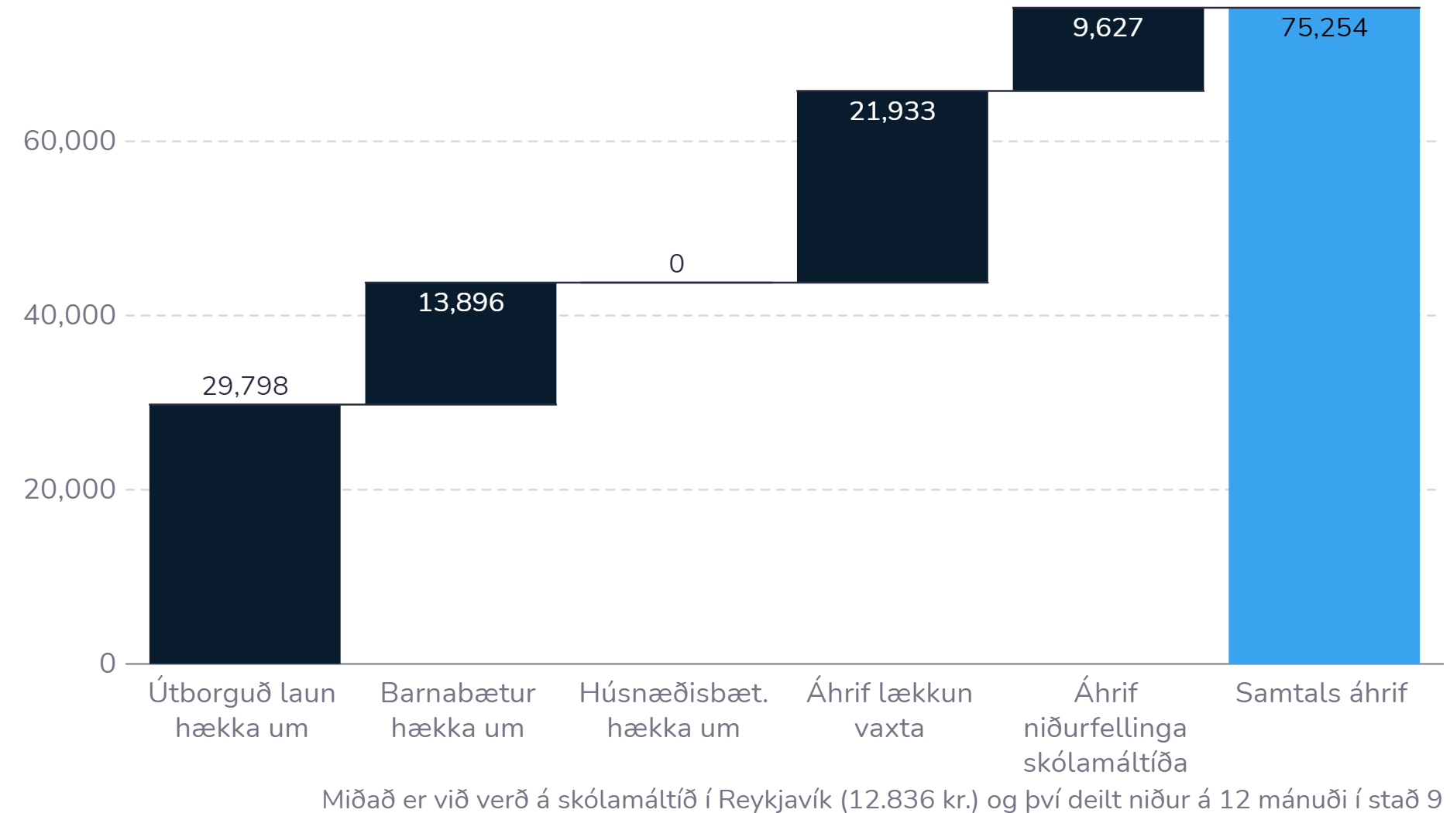
Example 1
Spouses/cohabitants with average VR salary
Two children, one in kindergarten, the other in elementary school
Live in own home
Assuming a 30 million ISK housing loan for 30 years
Útborguð laun = paid salary
Barnabætur = child benefit
Húsnæðisbætur = housing benefit
Lækkun vaxta = Lower interest rates
Skólamáltíð = Free school meals

Slide 10
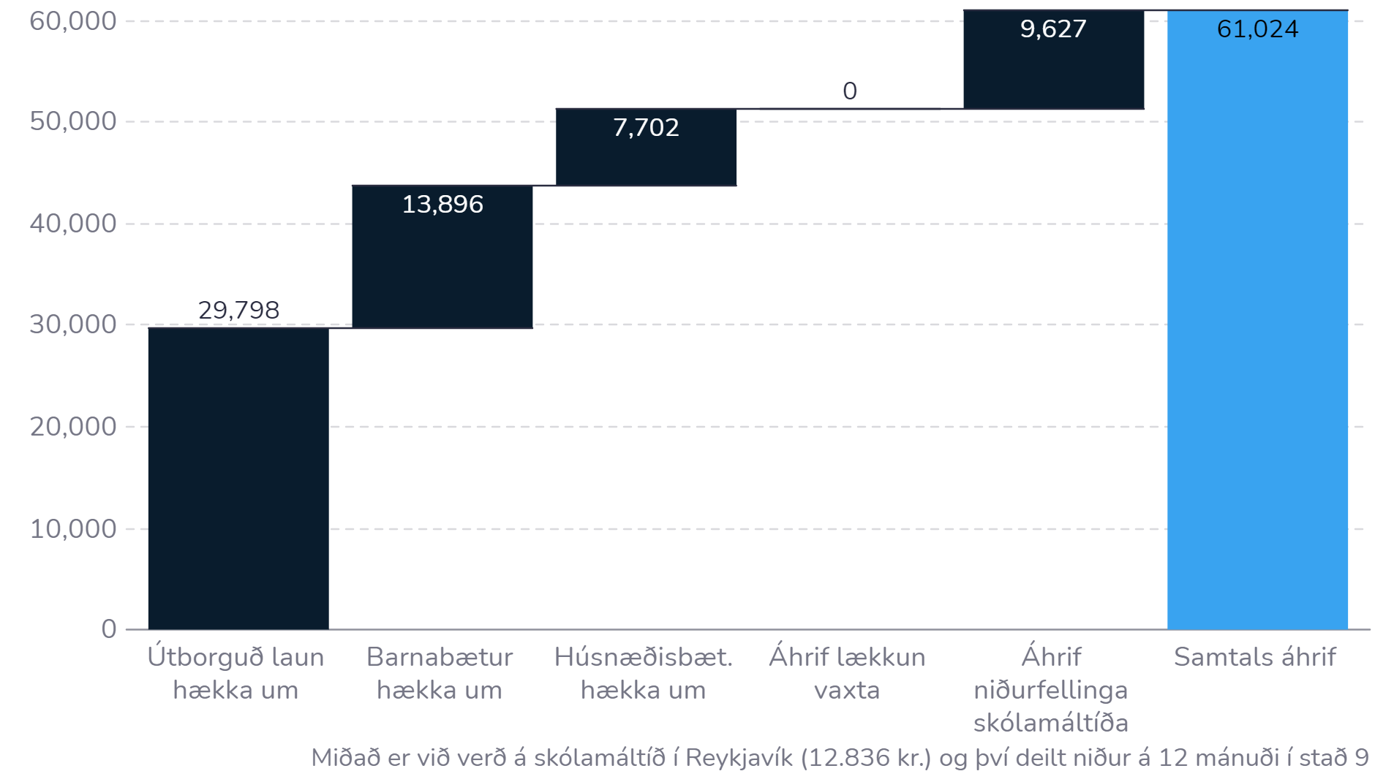
Example 2
Spouses/cohabitants on average VR salary
Two children, one in kindergarten, the other in primary school
Live in rented accommodation
Útborguð laun = paid salary
Barnabætur = child benefit
Húsnæðisbætur = housing benefit
Lækkun vaxta = Lower interest rates
Skólamáltíð = Free school meals

Slide 11
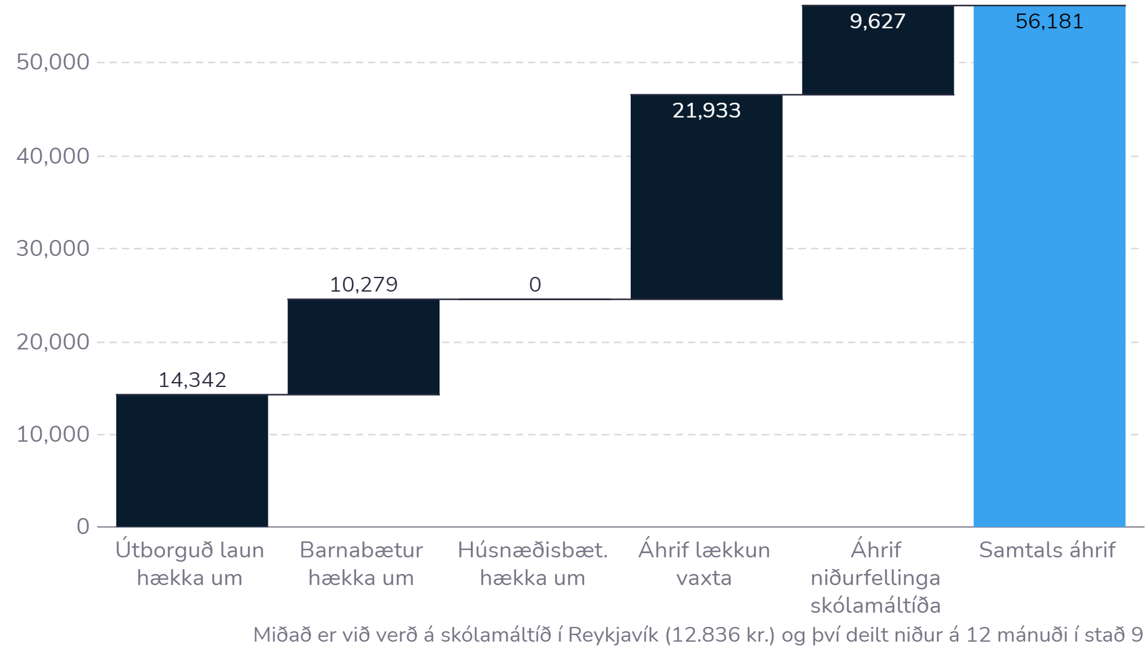
Example 3
A person on average salary VR
Two children, one in kindergarten, the other in primary school
Lives in own house
M.v. 30 million ISK loan for 30 years
Útborguð laun = paid salary
Barnabætur = child benefit
Húsnæðisbætur = housing benefit
Lækkun vaxta = Lower interest rates
Skólamáltíð = Free school meals

Slide 12
Example 4

Slide 13
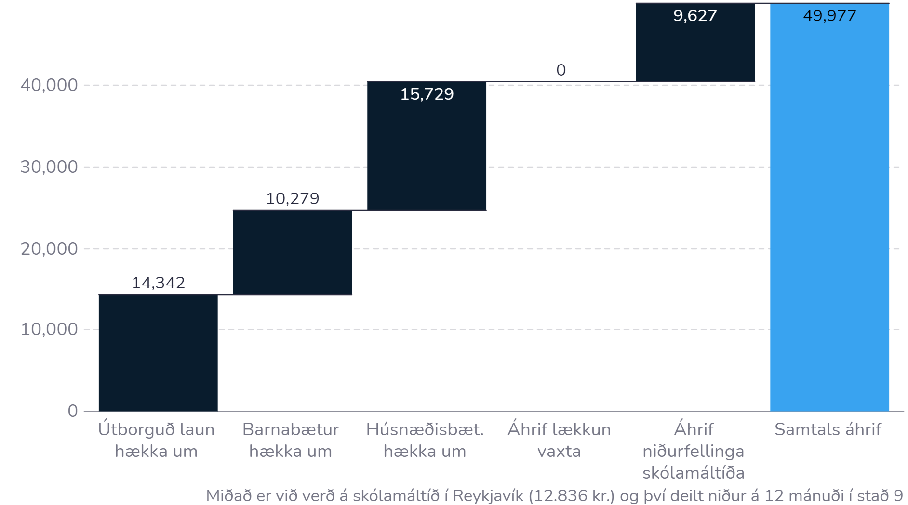
Example 4
A person on average salary VR
Two children, one in kindergarten, the other in primary school
Lives in rented accommodation
Útborguð laun = paid salary
Barnabætur = child benefit
Húsnæðisbætur = housing benefit
Lækkun vaxta = Lower interest rates
Skólamáltíð = Free school meals

Slide 14
Other matters
A special chapter on remote work is now part of a collective agreement that better defines what is included in such a work arrangement and stipulates that a written agreement must be made on regular remote work. A telecommuting agreement must, among other things, stipulate that each employer compensates or pays direct costs resulting from remote work and provides workforce for appropriate technical assistance.
Employees now have the right to devote up to 16 daytime working hours per year to attending professional courses without a reduction in salary.
Employees who complete vocational training in trade and services or receive confirmed skills with a professional certificate are now entitled to request a review of their salary and its composition.
It will now be permitted to elect three union representatives within a company if the number of members exceeds 120 in the same workplace. Union representatives also get an increased right to attend courses without a reduction in pay.
A clause in the collective agreement stipulates the importance of employees being able to disconnect outside of defined working hours, in order to, promote a healthy working environment. Employers and staff must agree on normal standards.

Slide 15
Conditional clauses
In order to strengthen the objectives of the collective agreements, a special wage and conditions committee shall be set up, made up of SA representatives and representatives nominated by the negotiation committees of the ASÍ member companies that are responsible for the common contract conditions.
The task of the committee is to monitor the progress of those factors in the economy that can affect the objectives of the agreement, make a formal assessment of the conditions of the collective agreement and, as the case may be, negotiate a response to the failure of the conditions or prerequisite.
  In September 2025, a formal position must be taken on the following assumptions:
  12-month inflation in August 2025 will not exceed 4.95%. However, this assumption is considered to have been met if inflation in the 6-month period from March to August 2025 is 4.7% or lower compared to the annual rate.
  Legal changes that are promised and stated in the statement of the government of Iceland, dated March 7th. 2024, shall have succeeded.
  In September 2026, a preliminary position must be taken on the following assumption:
  12-month inflation in August 2025 will not exceed 4.7%. However, this assumption is considered to have been met if inflation in the 6-month period from March – August 2025 is 4.4% or lower compared to the annual rate.

Slide 16
Prerequisite failure
If the wages and conditions committee comes to the conclusion that the prerequisite of the agreement have not been met. A response must be negotiated that has a positive effect on the progress towards goals that the parties to the agreement have set for themselves regarding lower inflation, inflation expectations, a reduction in the key interest rate and improved benefits for workers and improved competitiveness of the Icelandic economy.
If an agreement cannot be reached on a response to a breach of the prerequisites, the contracting parties have the right to terminate the contract in the following manner:
Due to a review in September 2025, the termination of the contract must be notified before 16:00 on October 8, 2025, and the contract will then expire on October 31, 2025.
Due to a review in September 2026, the termination of the contract must be notified before 16:00 on October 8, 2026, and the contract will then expire on October 31, 2026.

Slide 17
Special wage agreements
An amendment was made to the special wage agreement between VR/LÍV and SA regarding staff in pharmacies, which stipulates that in those pharmacies where special footwear is required at work, the employer must provide permanent staff with one pair of shoes per year.
A change was made to the special wage agreement between VR/LÍV and SA for the reception staff, which stipulates that trips to and from the workplace in the capital area will be paid for by the employer, during the time that the buses are not running. The same rule applies in other urban areas where public buses run from morning to night every day of the week. The payment is 1,975, but the amount must be updated at the same time as general salary increases according to the consumer price sub-index 07322 taxi (227.1).
The special wage agreement between VR/LÍV and Icelandair/SA regarding personnel in passenger and loading services at Keflavík Airport was under review and, as is known, it was required that the shift schedule be changed. A protocol was agreed that work would be done to change the arrangement and that work must be completed no later than December 20, 2024.

Slide 18
Overview
The new LÍV and SA collective agreements apply from February 1, 2024 to January 31, 2028.
The agreement stipulates a general proportional increase in monthly wages, with a certain ISK increase as a minimum, in each year of the agreement period.
Holiday entitlements have been increased, December and holiday supplements have been increased, and possible additional salary increases have been secured through productivity increases and purchase rate increases (if conditions are met).
The goal of the agreement is to increase the purchasing power of workers by reducing inflation and interest rates, with the government's actions in relation to child benefits, housing benefits, interest support, etc. contributing towards that goal.
Prerequisite clauses ensure that it will be possible to monitor the progress of factors in the economy and react if the goals of the agreement are not met.
Collective bargaining agreements have been reviewed and many other issues have come through, e.g. in relation to remote work and the right of employees to attend work-related courses without reduction of salary.

Slide 19
Thank you

